Slide 1
Independent study
Lingpeng Chen 120090049

Slide 2

What I have done and learned independently this semester
Generally, I have done following thing:
First half semester:
1. The UAV landing under the disturbing ocean environment in Gazebo
2. Summarizing my work and help other students to continue relevant study based on my work
3. Publish a paper to RCAR
Second half semester:
1. Learning deep learning topic like:
Regression, Classification, CNN, Self-attention, Transformer, GAN, Bert, Explainable AI
2. Realize several small projects like:
Covid-19 prediction
Image classification
Semantic analysis of complaints from our school canteen
GAN (generate anime faces)
Interpretate image classification model

Slide 3
Image Classification and Interpretation

Slide 4
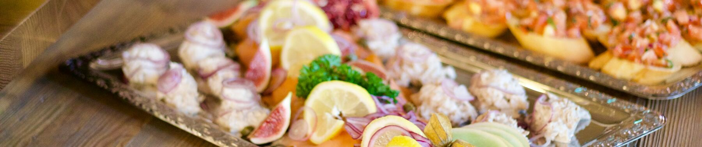
Outline
How to use deep learning method to classify food image?
How does the AI model think of food image?

Slide 5
Part I
How to use deep learning method to classify food image?

Slide 6
PART 1-1 Dataset
Food-11 image dataset
contains 11 categories of food:
Bread
Dairy product
Dessert
Egg
Fried food
Meat
Noodles-Pasta
Rice
Seafood
Soup
Vegetable-Fruit
Data
● Training set: 9866 labeled images
● Validation set: 3430 labeled images
● Testing set: 3347 images

Slide 7
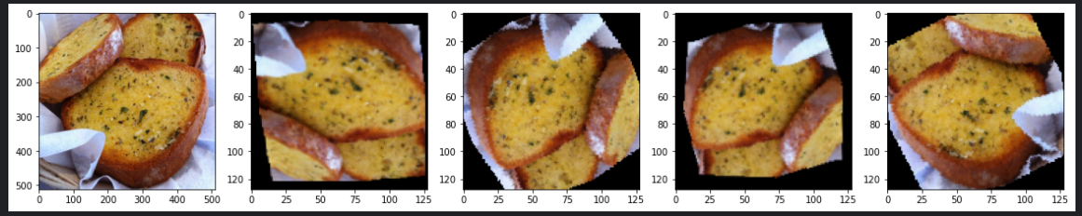
PART 1-2 Data Augmentation
Modify the image data to non-identical inputs and give them to the model each epoch, to prevent overfitting of the model.
1. RandomResizedCrop 2. RandomAffine
3. RandomPerspective 4. RandomHorizontalFlip
5. RandomVerticalFlip 6. RandomRoation
All these transformations are stacking together, a input picture will go through some of the transformations randomly.

Slide 8
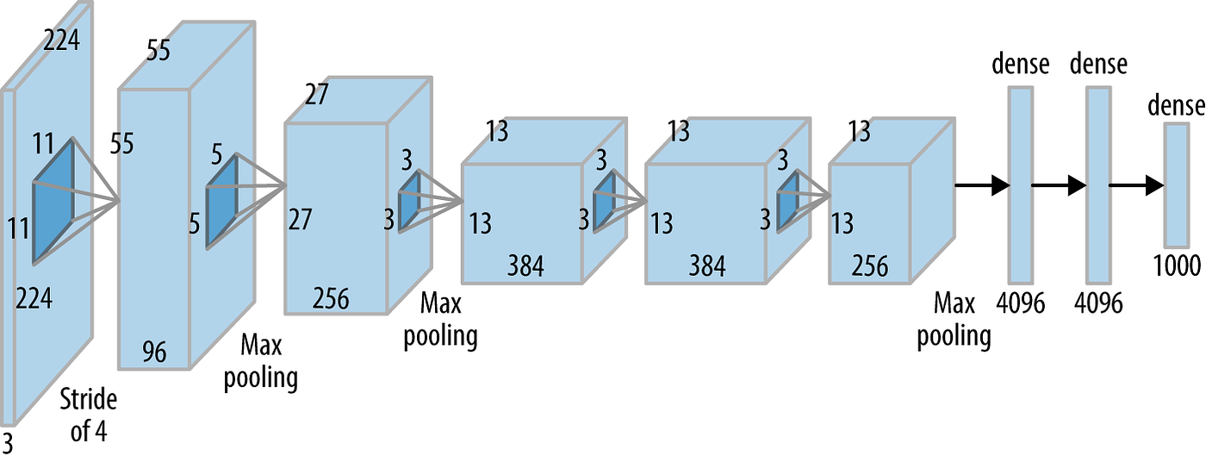
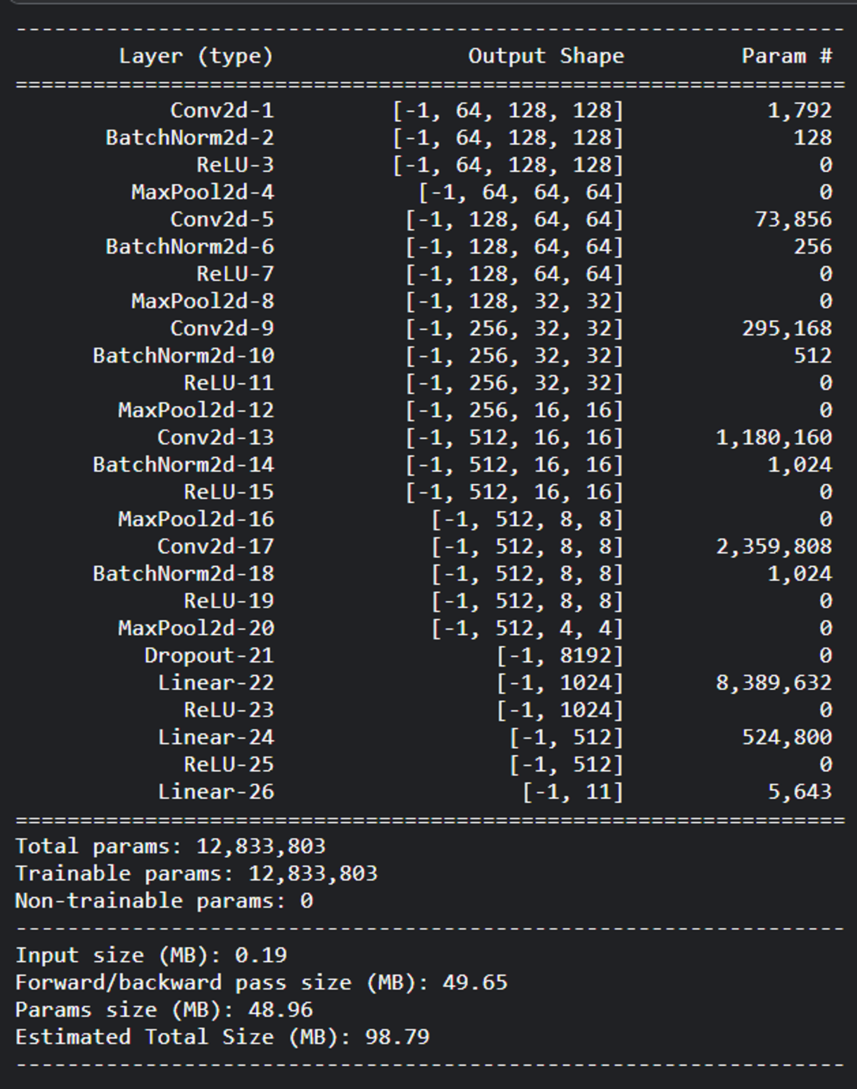
PART 1-3 Modified AlexNet - Model Structure
submodule
submodule
submodule
Our feature extraction network:
5 Concatenation of following submodule:
nn.Conv2d(3, xx, 3, 1, 1),
nn.BatchNorm2d(xx),
nn.ReLU(),
nn.MaxPool2d(2, 2, 0),
submodule
submodule
DNN

Slide 9
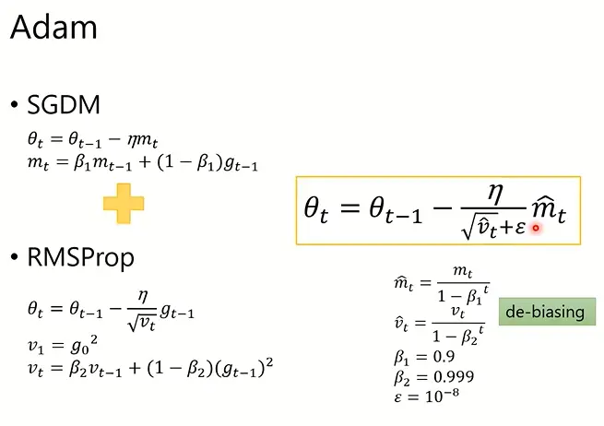
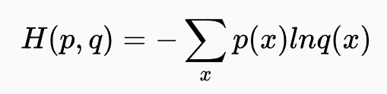

PART 1-3 Modified AlexNet - Loss Function & Optimizer
Loss function:
cross-entropy loss
optimizer:
ADAM

Slide 10
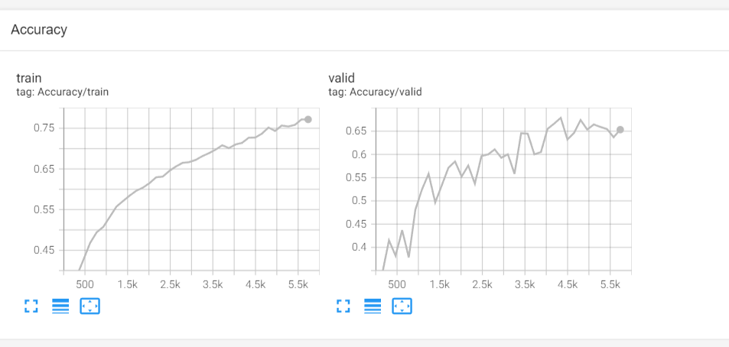
PART 1-3 Modified AlexNet - Training
For each batch:
Accuracy: the ratio of correctly predicted image.
For each epoch
Accuracy: take average of the accuracy and plot
on the tensorboard
Drawbacks:
time consuming (5 hours)
low performance

Slide 11
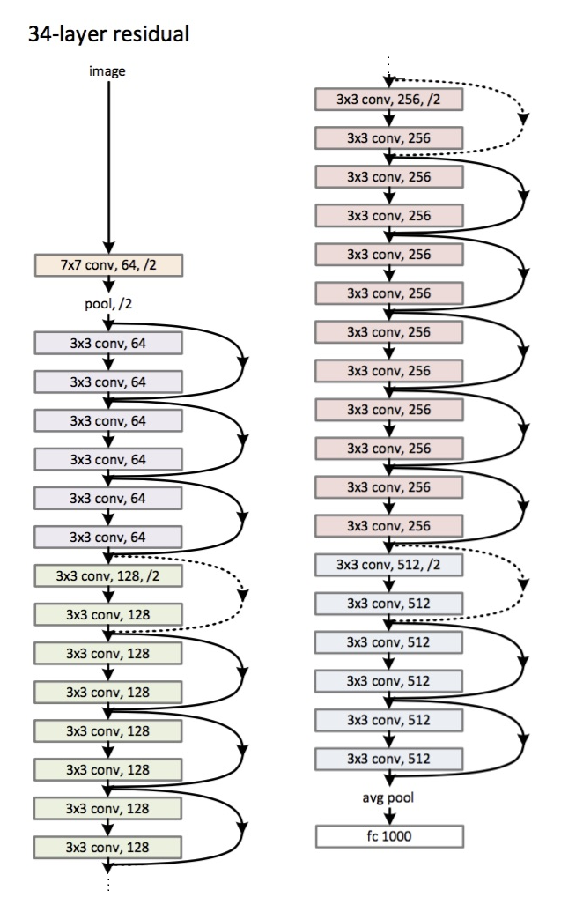
PART 1-4-1 Improvement - Choosing Pretrained Model
Resnet18 and 34
The output size of the feature extraction network is 512x7x7 for input images of size 3x224x224.
Directly imported the pre-trained model and adjusted our own classifier (DNN layer) to connect to the output of the CNN.

Slide 12
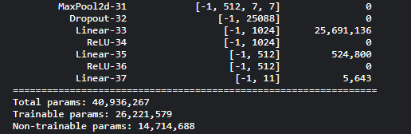
PART 1-4-1 Improvement - Choosing Pretrained Model
Resnet 18 and 34
training time did not decrease
reduce the dimensionality and size of the original 512*7*7 feature map by using a 3*3 convolutional operation, resulting in 64*5*5 feature map without losing too much information.
Parameters in modified Resnet model
Parameters of DNN in Resnet model

Slide 13
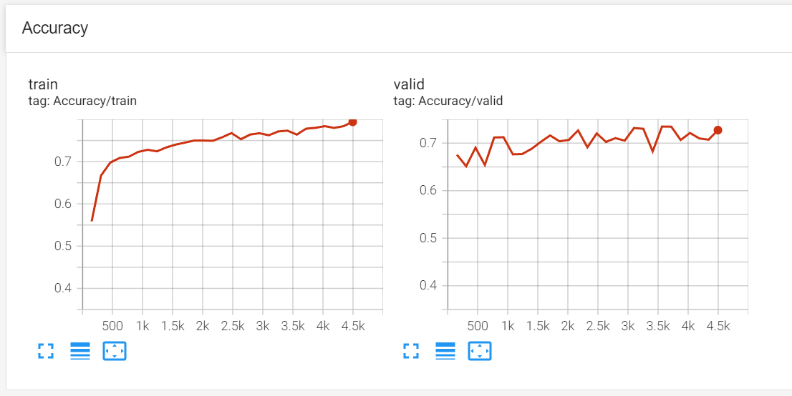
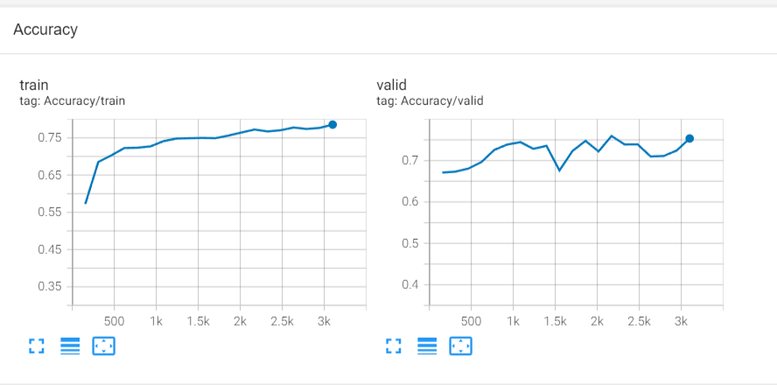
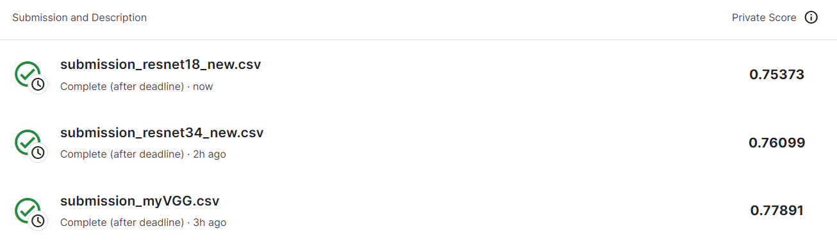
PART 1-4-1 Improvement - Choosing Pretrained Model
Resnet18 & Resnet34 performance
Resnet18
Resnet34

Slide 14
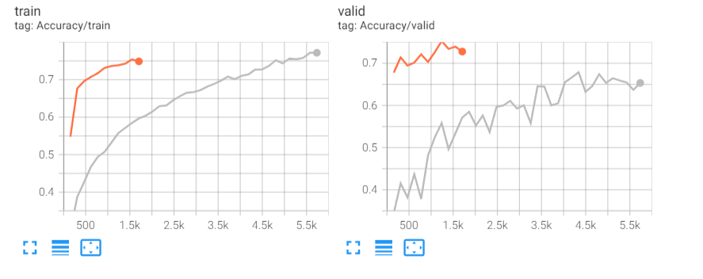
PART 1-4-1 Improvement - Choosing Pretrained Model
VGG16 performance
VGG 16 performance (orange line) 10 min
v.s.
The modified ResNet (gray line) 5 hours

Slide 15
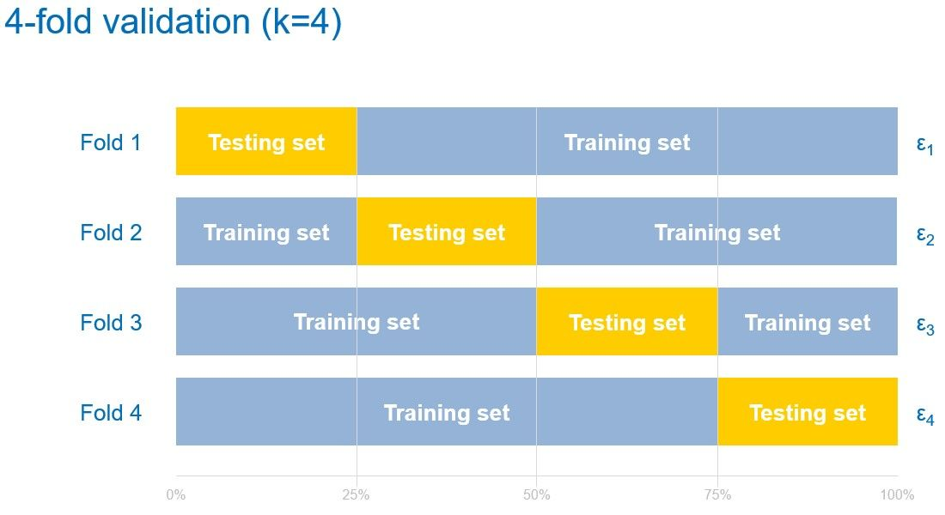
PART 1-4-2 Improvement - Cross Validation + Ensemble
Cross Validation
Combining the training and validation sets together.
Divide the combined dataset into 4 non-overlapping subsets. Each time, use three of the subsets as the training set and the remaining one as the validation set
Repeating the training process 4 times to get 4 models

Slide 16
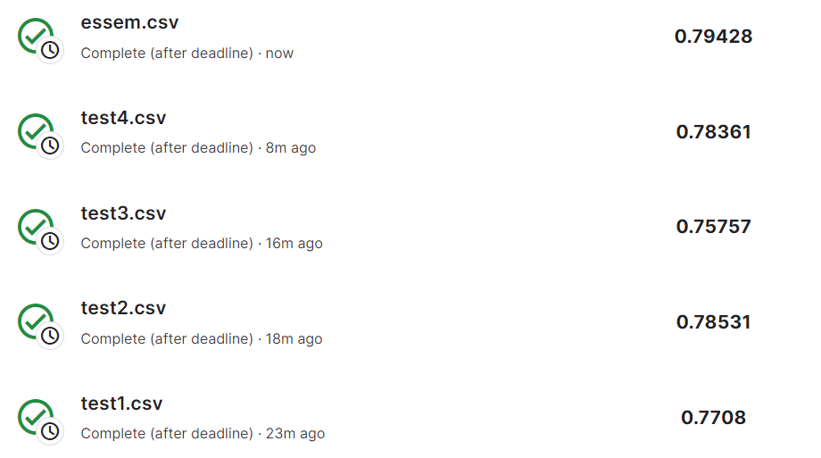
PART 1-4-2 Improvement - Cross Validation + Ensemble
Ensemble
Since we have 4 models, when doing induction, every picture has 4 outputs
Sum them together and use the argmax to get the class label of the picture

Slide 17
PART 1-4-3 Improvement – Focal loss
Fine-tuning
Increase the diversity of our model
Replace cross-entropy loss with FocalLoss
Handle the problem of imbalanced data – setting alpha
Bread | Dairy product | Dessert | Egg | Fried Food | Meat | Noodles-Pasta | Rice | Seafood | Soup | Vegetable-Fruit
1356 | 573 | 2000 | 1313 | 1174 | 1774 | 587 | 376 | 1202 | 2000 | 941

Slide 18
Part II
How does the AI model think of food image?

Slide 19
PART 2
Interpretate model
Local Explanation
Why do the model think a pizza image is a pizza?
Global Explanation
What does a “pizza” looks like in the eyes of the model?

Slide 20
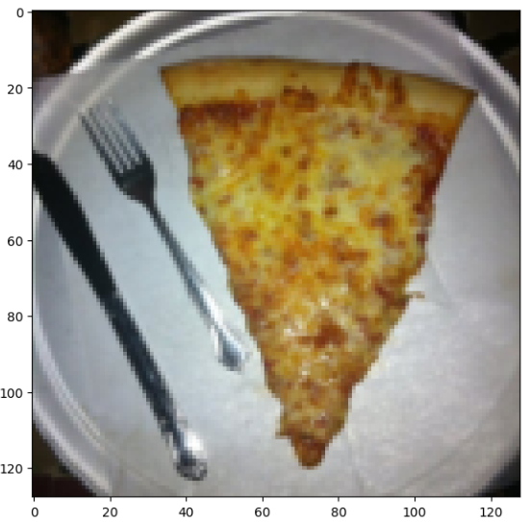
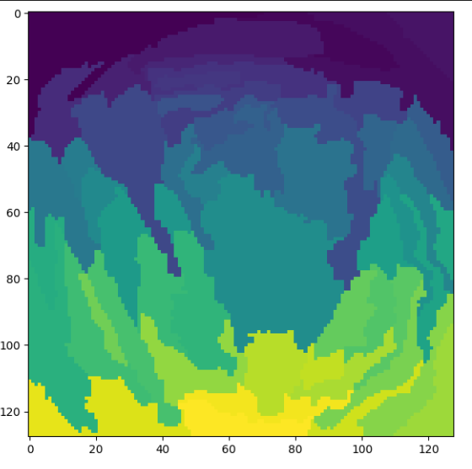
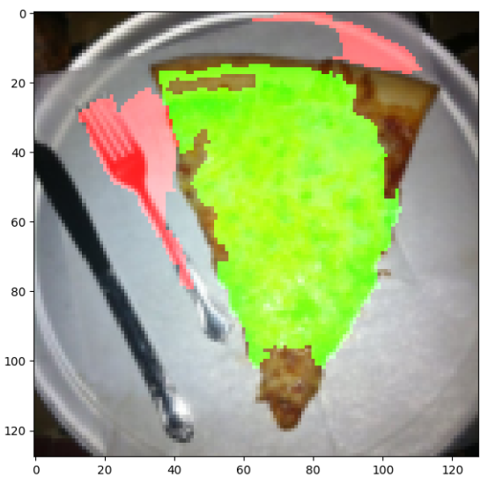
PART 2-1-1 Local Explanation I – which part is important?
Local Explanation
Which part of the image is the most important to let the model determine this picture is a “pizza”
Split the image into 100 pieces with the help of segmentaion from skimage
Use Lime (Local Interpretable Model Agnostic Explanations) to judge which position of the picture is more important.

Slide 21
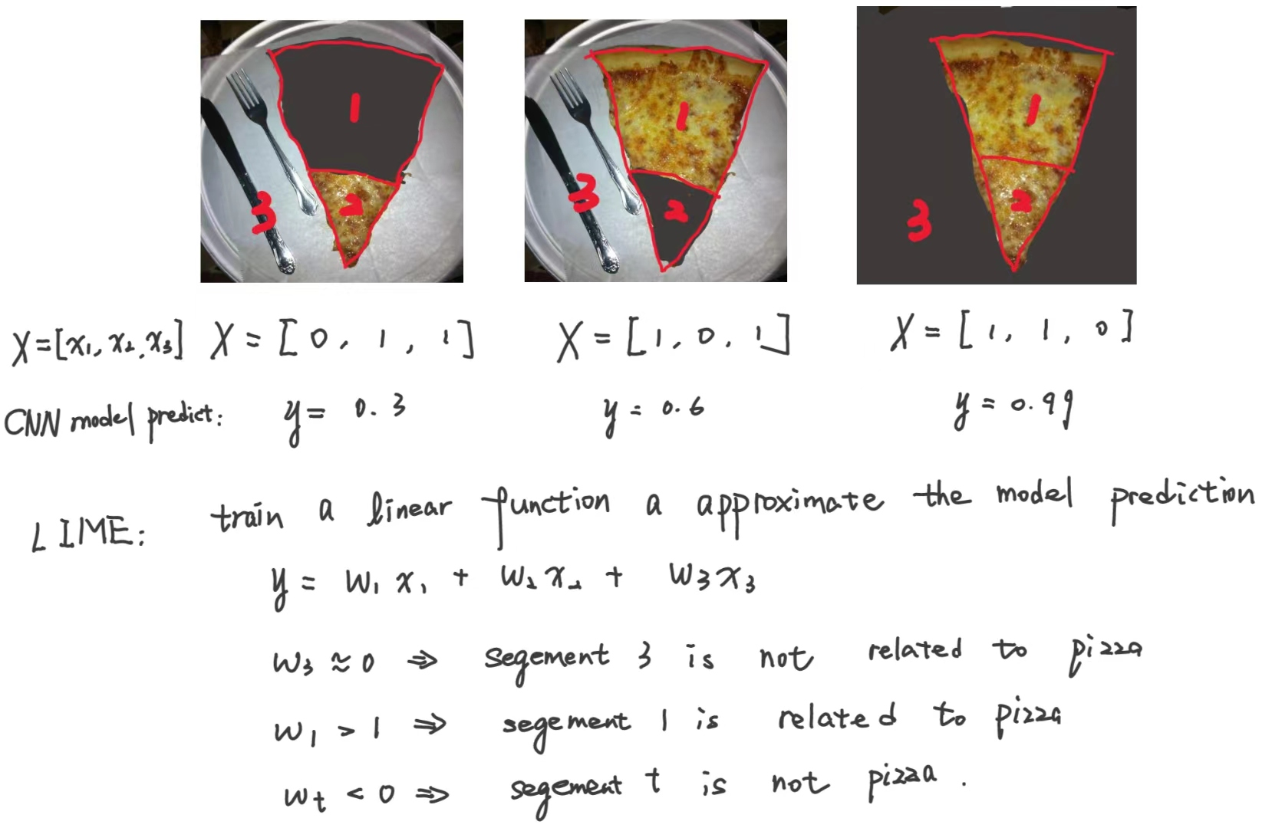
PART 2-1-1 Local Explanation I – which part is important?
Lime algorithm
Use Lime (Local Interpretable Model Agnostic Explanations) to train a linear function whose inputs are image patches and whose outputs approximate those of a model.
The importance of different image regions is then inferred by examining the weights of the linear functon.
https://www.oreilly.com/content/introduction-to-local-interpretable-model-agnostic-explanations-lime/

Slide 22
PART 2-1-1 Local Explanation I – which part is important?
Local Explanation
Which part of the image is the most important to let the model determine this picture is a “pizza”
Split the image into 100 pieces with the help of segmentaion from skimage
Use Lime (Local Interpretable Model Agnostic Explanations) to judge which position of the picture is more important.

Slide 23
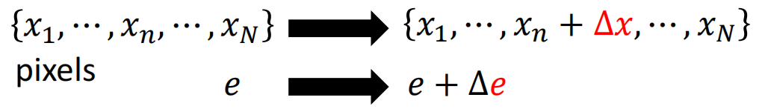
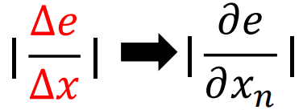
PART 2-1-2 Local Explanation II – Saliency map
Local Explanation (Saliency Map)
The heatmaps that highlight pixels of the input image that contribute the most in the classification task.
The generation of saliency map is closely similar to train a model.
During training, we calculate the partial differential value of loss to model parameters.
In saliency map, we calculate the partial differential value of loss to image pixel, which means the importance of the pixel.

Slide 24
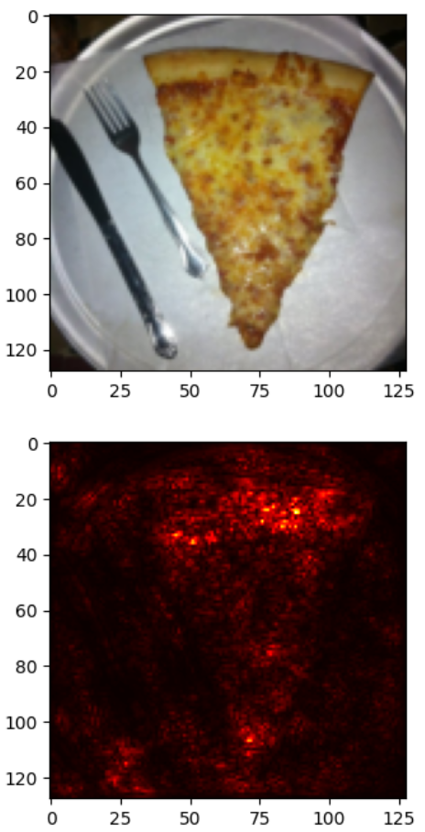
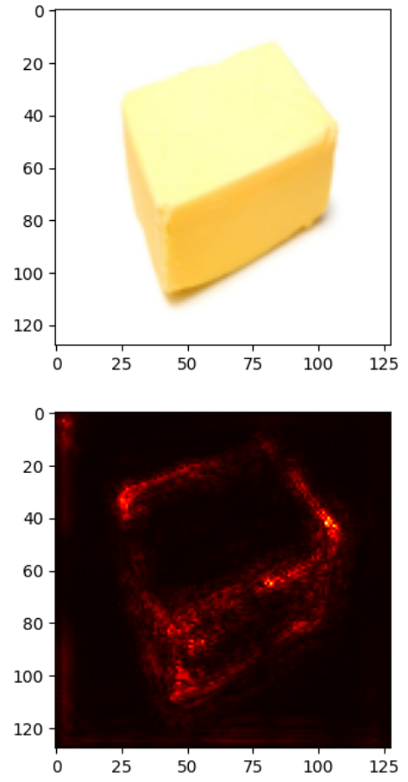
PART 2-1-2 Local Explanation II – Saliency map
Local Explanation (Saliency Map)
The heatmaps that highlight pixels of the input image that contribute the most in the classification task.

Slide 25
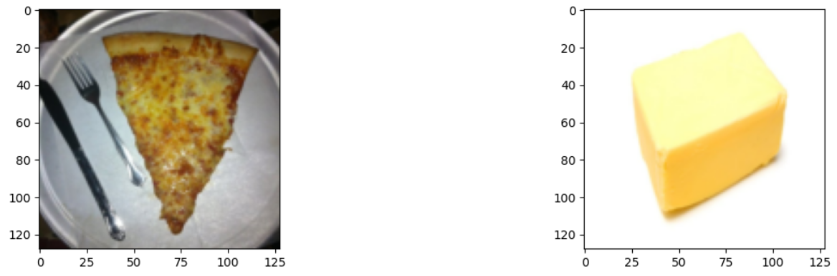
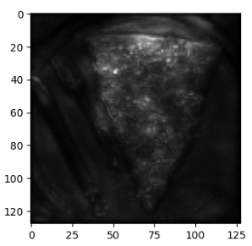
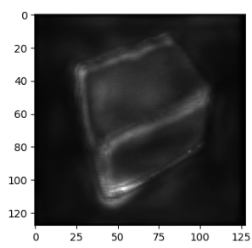
PART 2-1-3 Local Explanation III – Smooth Grad
Local Explanation (Saliency Map – Smooth Gradient Method)
The method of Smooth grad is to randomly add noise to the image and get different heatmaps. The average of the heatmaps would be more robust to noisy gradient.
ref: https://arxiv.org/pdf/1706.03825.pdf

Slide 26
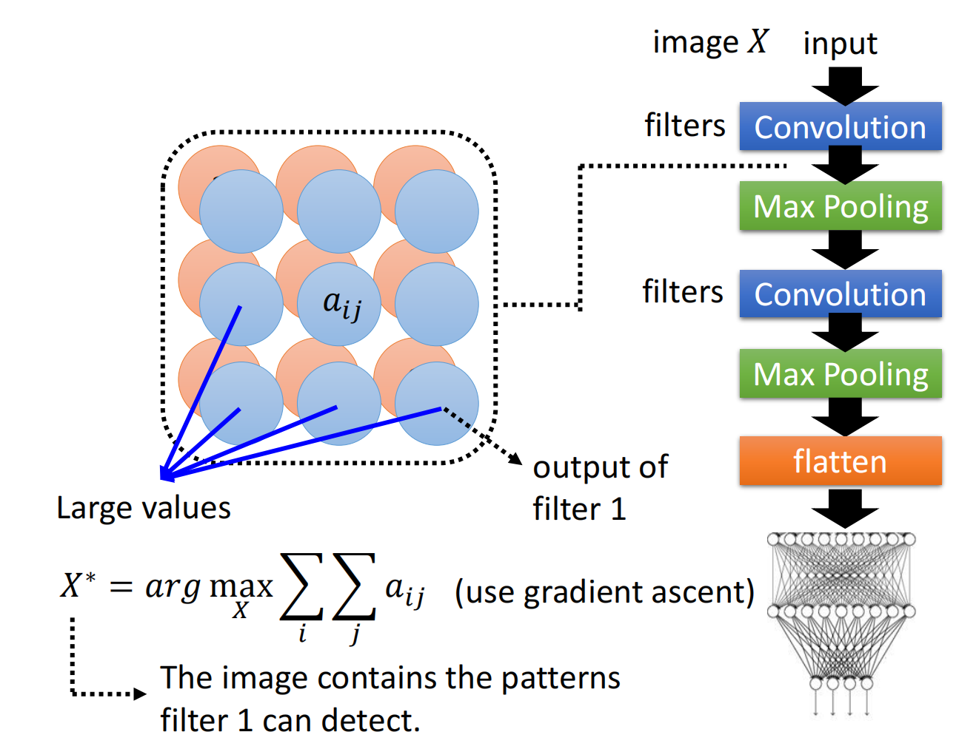
PART 2-2 Gobal Explanation
Global Explanation (filter explanation)
In order to know what a specific filter recognize, we'll do filter visualization: look for which kind of image can activate the filter the most
How can we get the output of a specific layer of CNN?
We can modify the model definition, make the forward function not only return loss but also return the activation map. Pytorch offers a better solution: hook
hook_handle = model.cnn[cnnid].register_forward_hook(hook)
1st filter on the 1st convolution kernel
objective = - fiilters[:, filterid, :, :].sum()

Slide 27
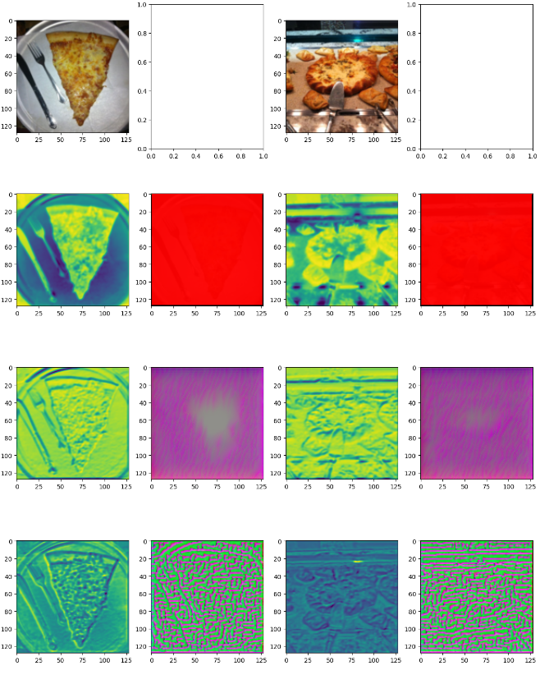
PART 2-2 Gobal Explanation – Filter explanation
What does activated filter looks like
The input image that maximize the filter
Conv1
Conv2
Conv3

Slide 28
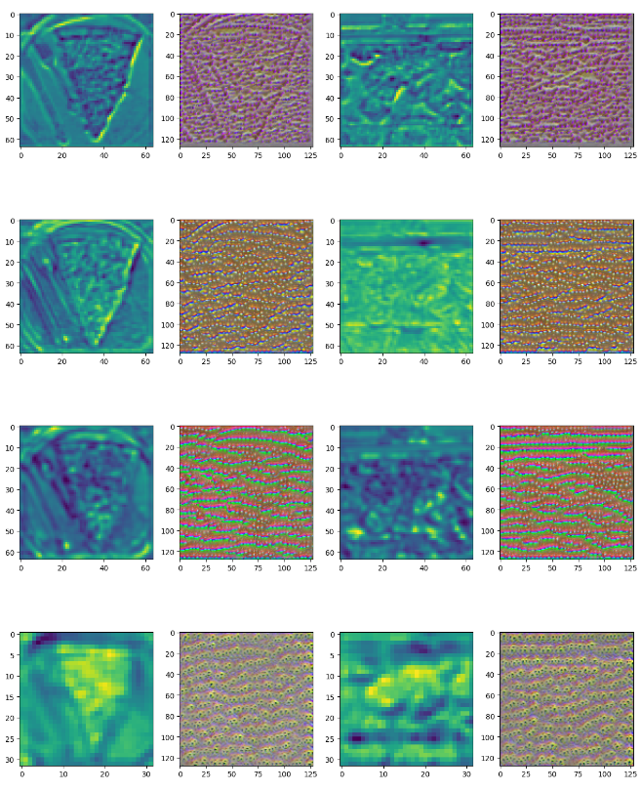
PART 2-2 Gobal Explanation – Filter explanation
Conv4
Conv5
Conv6
Conv7

Slide 29
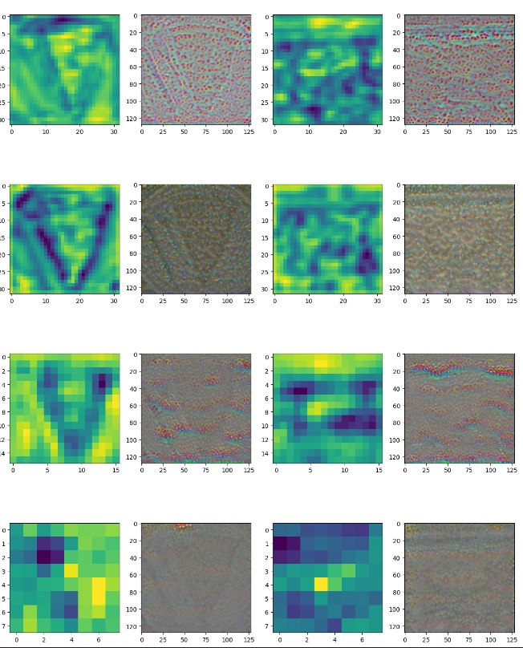
PART 2-2 Gobal Explanation – Filter explanation
Conv8
Conv9
Conv10
Conv11

Slide 30
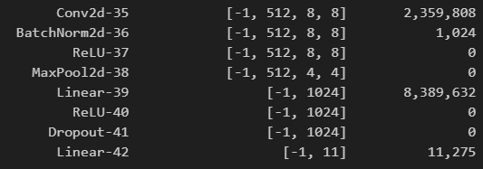
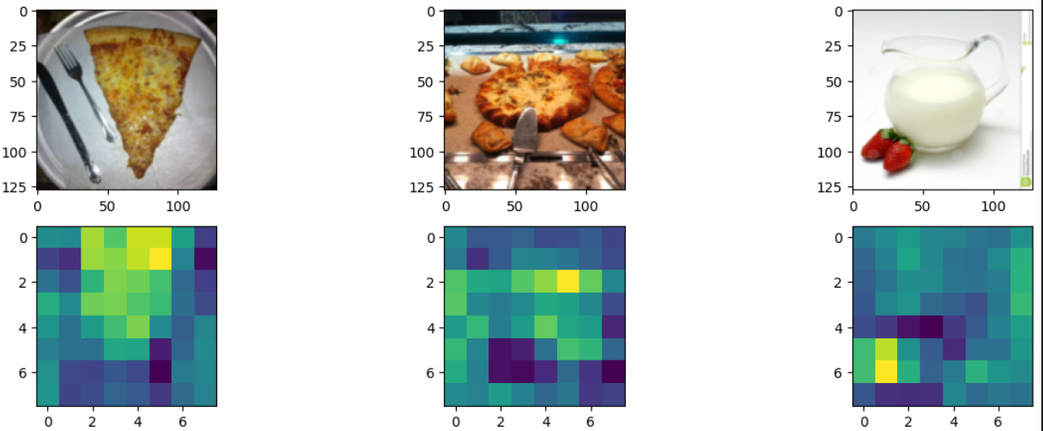
PART 2-2 Gobal Explanation – Filter explanation

Slide 31
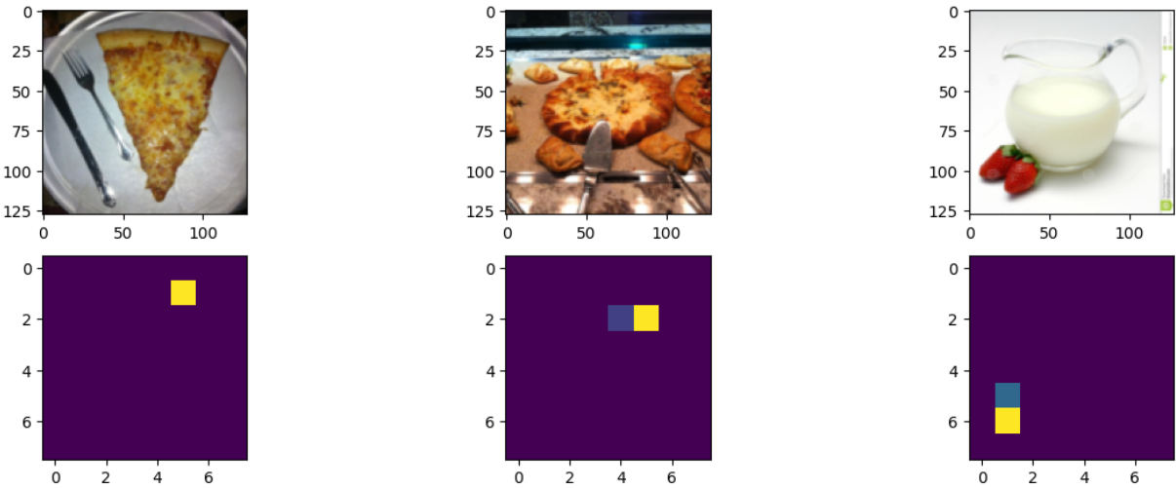
PART 2-2 Gobal Explanation – Filter explanation

Slide 32
Sum up
How to use deep learning method to classify food image?
How does the AI model think of food image?

Slide 33
THANK YOU!

